Slide 1
Visualization of Neural Networks
Seminar in Computer Graphics 2019
David Bauer & Lukas Masopust

Slide 2
TensorFlow’s Visualization API
Wongsuphasawat et al. 2018
[1]

Slide 3
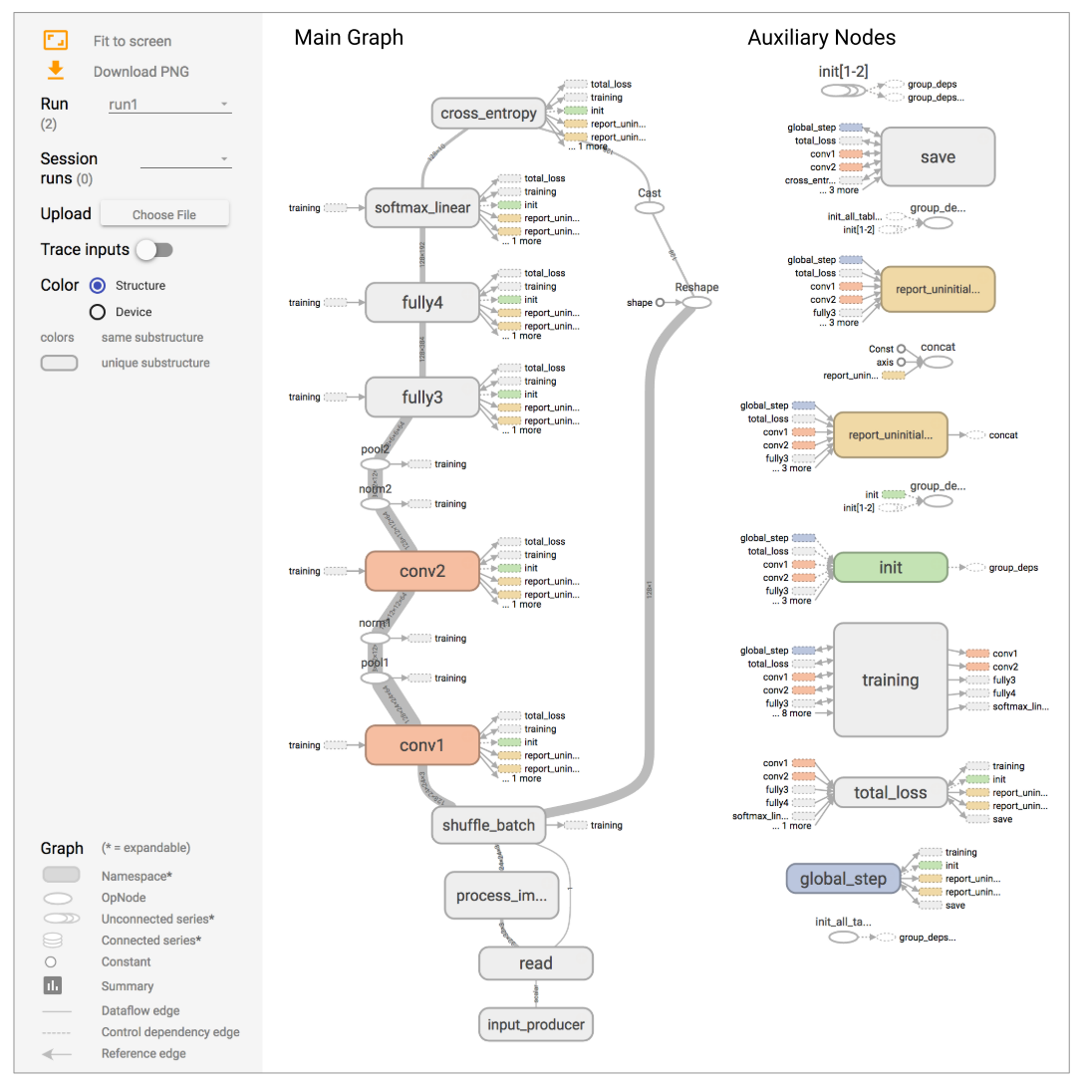
TensorFlow’s Visualization API
Whole Networks
Flow Layout Graph
Omission of Non-Critical Operations
Clustered Graph
Omission and Extraction
[1]

Slide 4
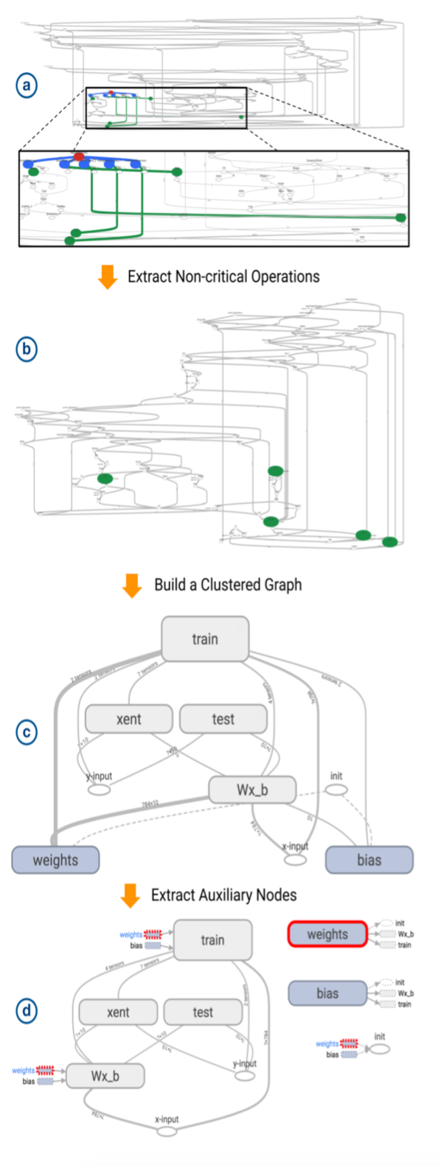
[1]

Slide 5
TensorFlow Playground
Smilkov et al. 2017
[2]

Slide 6
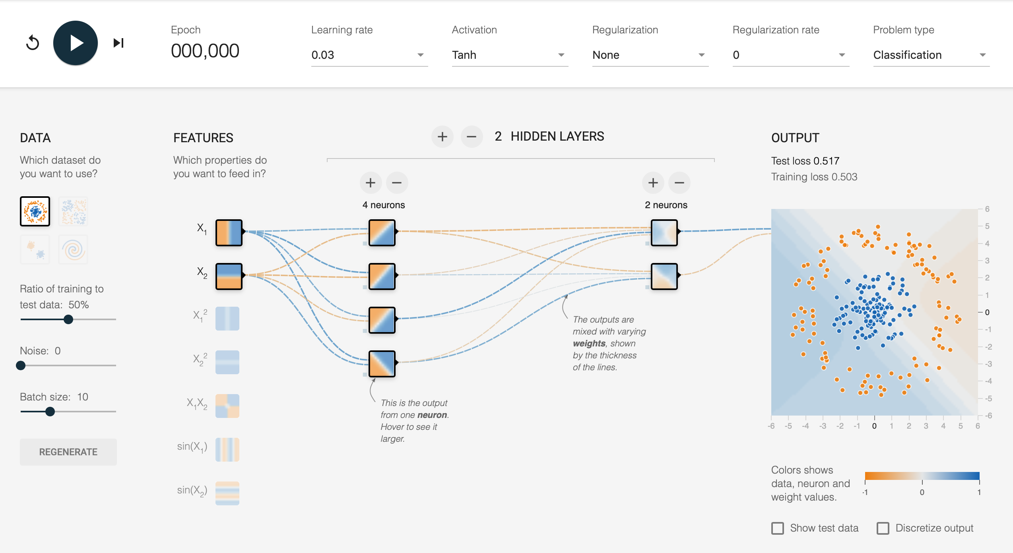
[2]

Slide 7
Multi-Neuron Activation Visualization
Yosinski et al. 2015
[3]

Slide 8
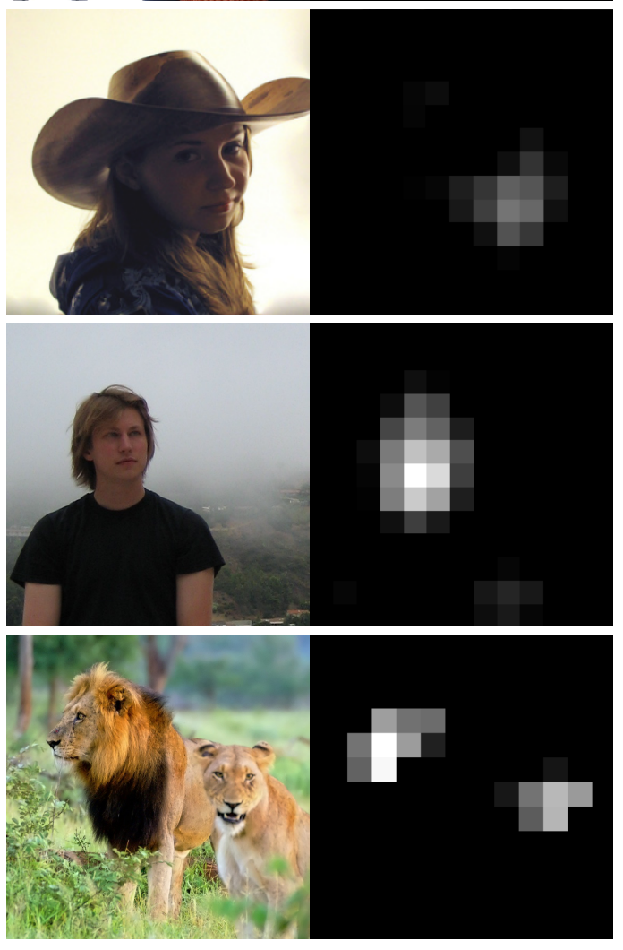
Multi-Neuron Activation Visualization
Open-Source
Live Visualization
Neuron-Wise Representation
Layer-Wise Representation
[3]

Slide 9
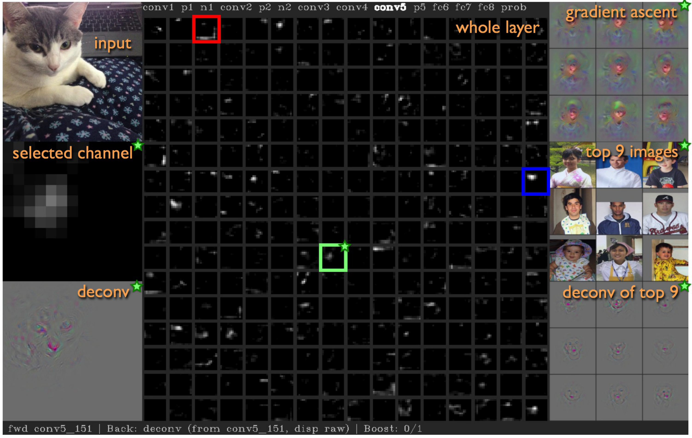
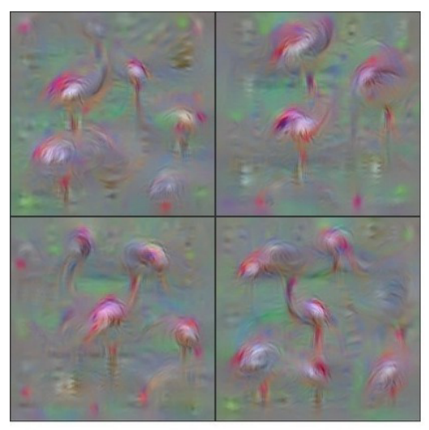
[3]
[3]

Slide 10
Regional Relevance Visualization
Samek et al. 2017
[4]

Slide 11
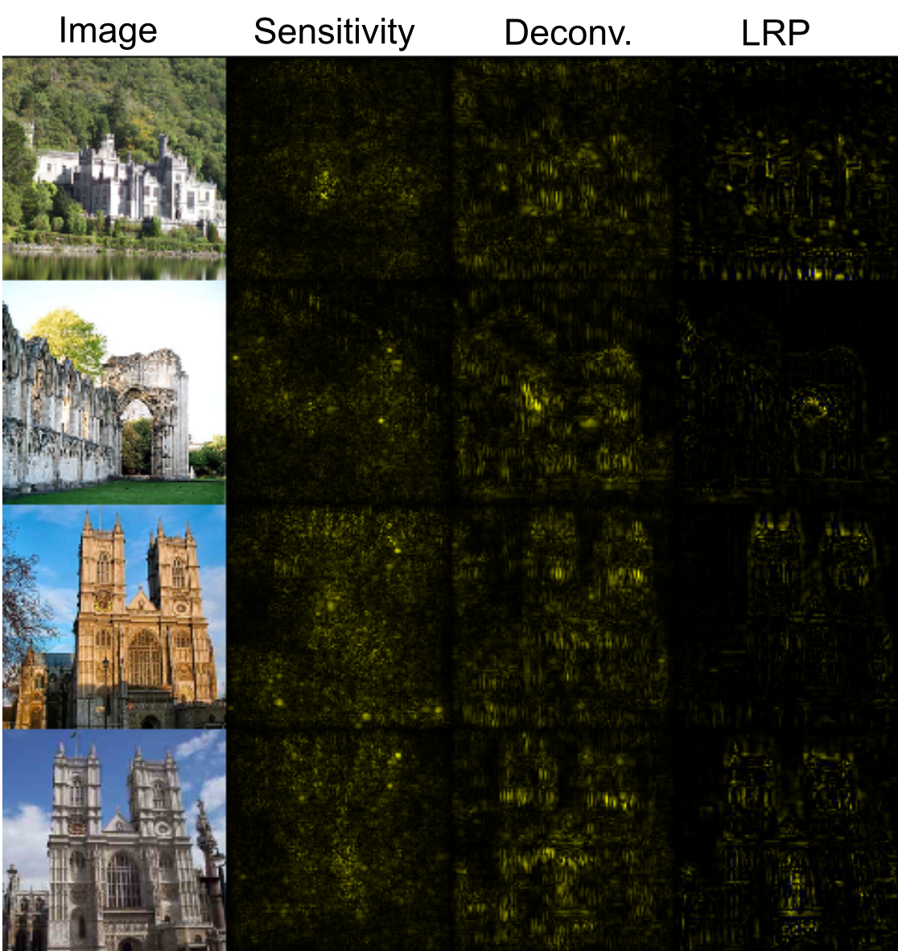
Regional Relevance Visualization
Heatmap-Based
Sensitivity
Deconvolution
Relevance (LRP)
[4]

Slide 12
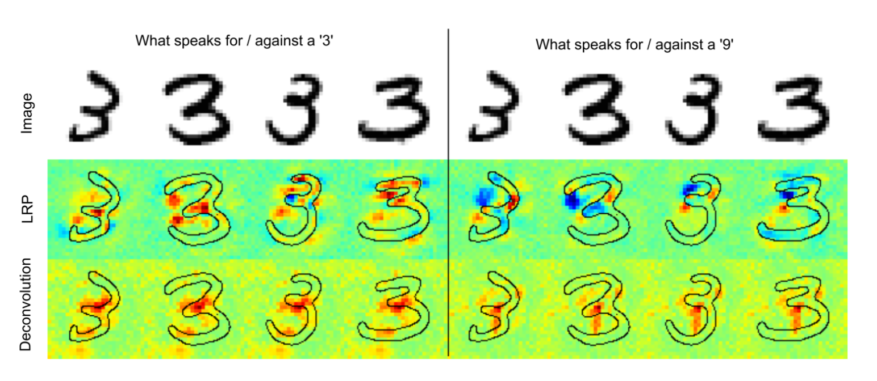
[4]

Slide 13
Multifaceted Feature Visualization
Nguyen et al. 2016
[5]

Slide 14
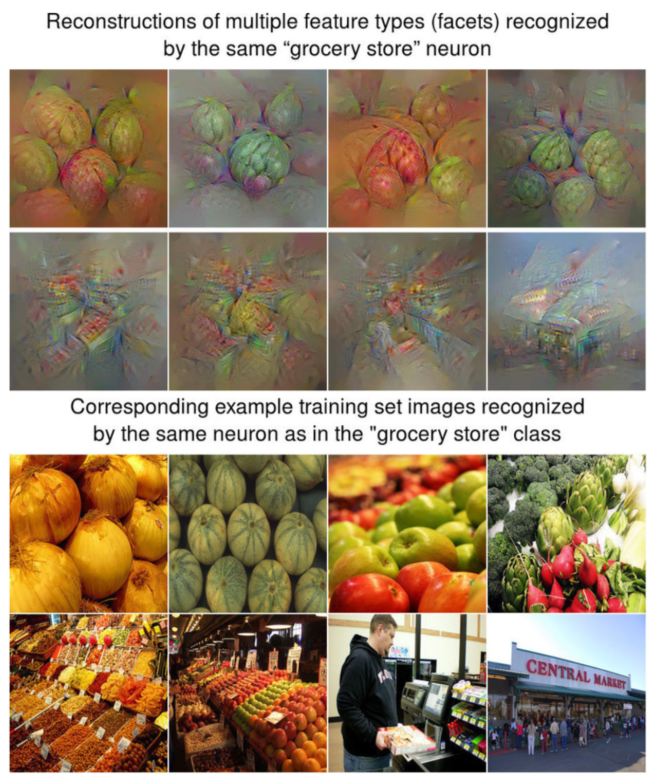
Multifaceted Feature Visualization
Multiple Features per Neuron
Facet Clustering
Reconstructing ‘Ideal’ Image
[5]

Slide 15
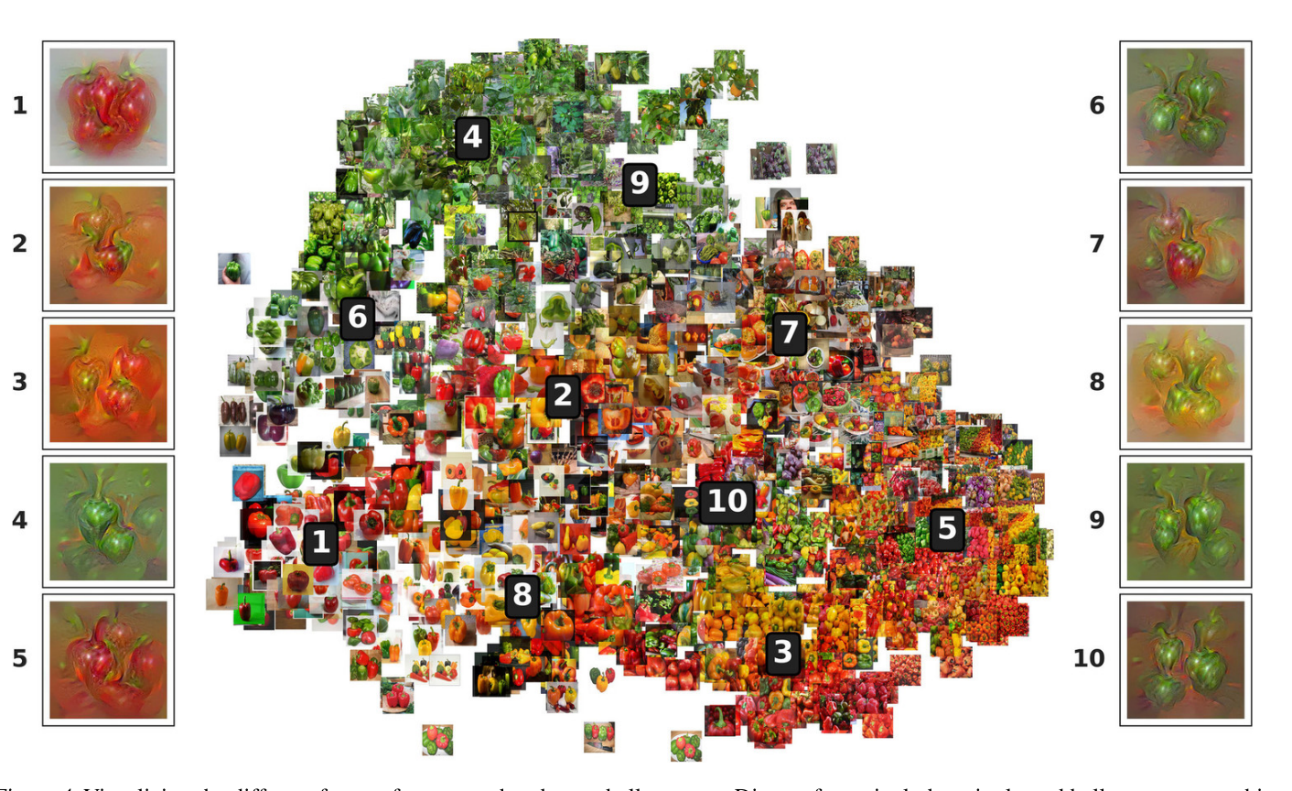
[5]

Slide 16
CNNVis
Liu et al. 2016
[6]

Slide 17
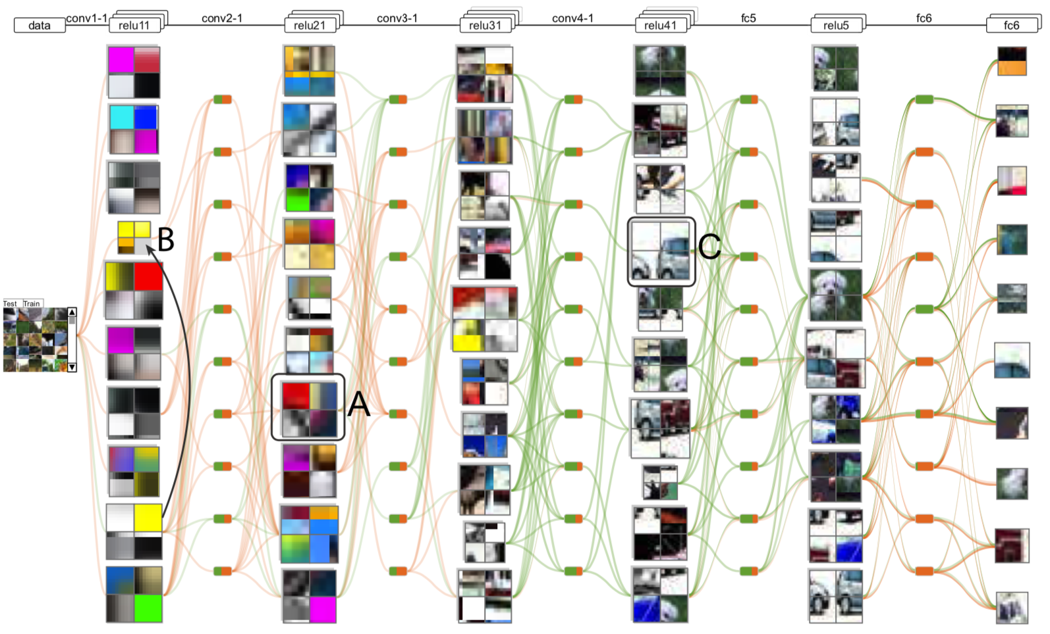
CNNVis
Layer-Wise Visualization
Neuron-Wise Visualization
Edge Weighting
Relevance Grading
[6]

Slide 18
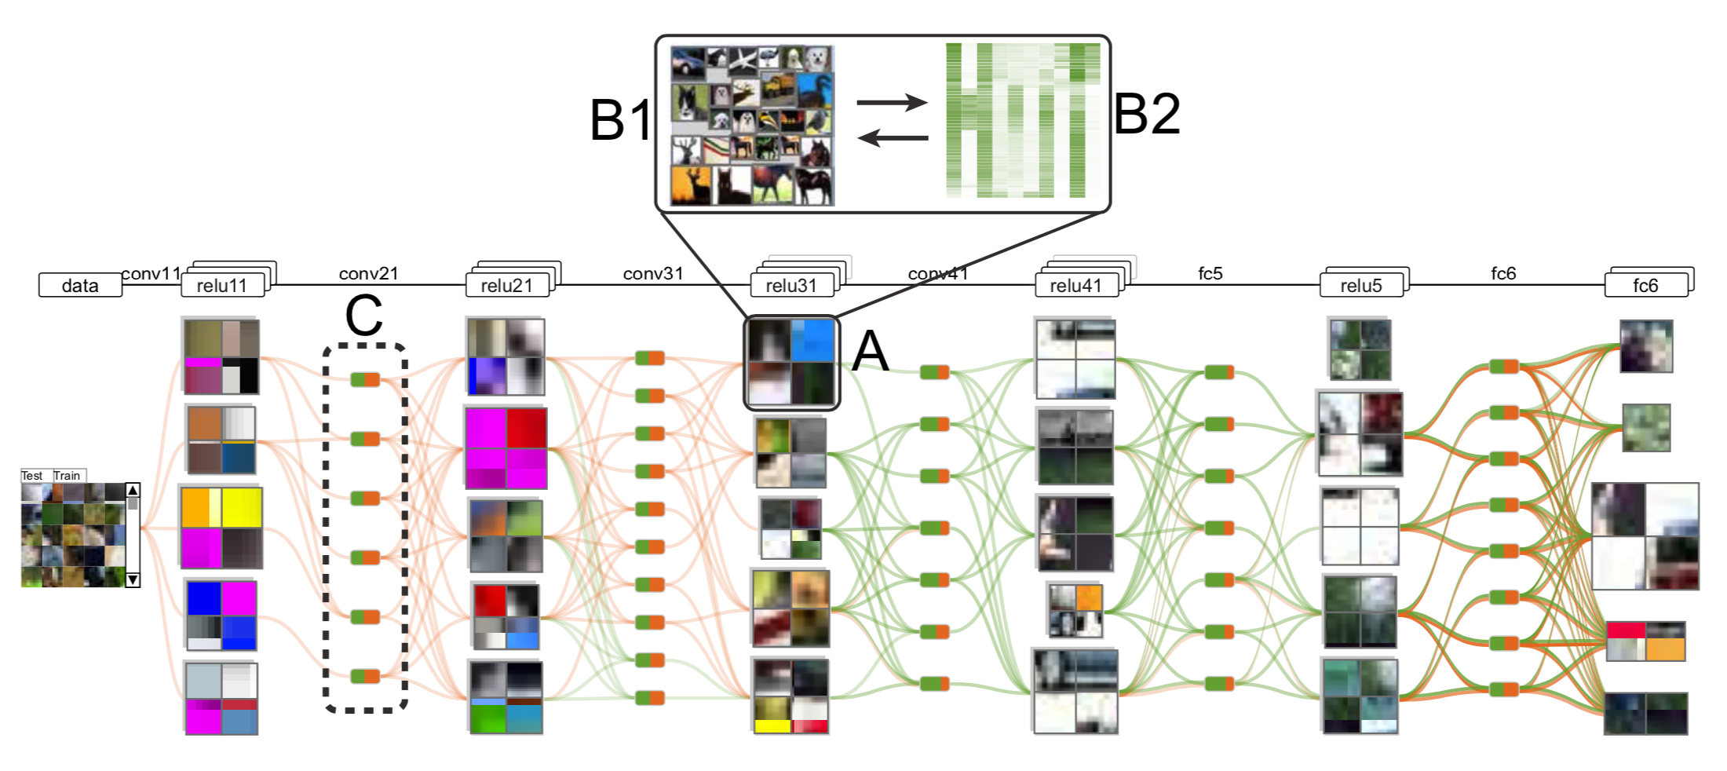
[6]

Slide 19
Analyzing DGMs
Liu et al. 2018
[7]

Slide 20
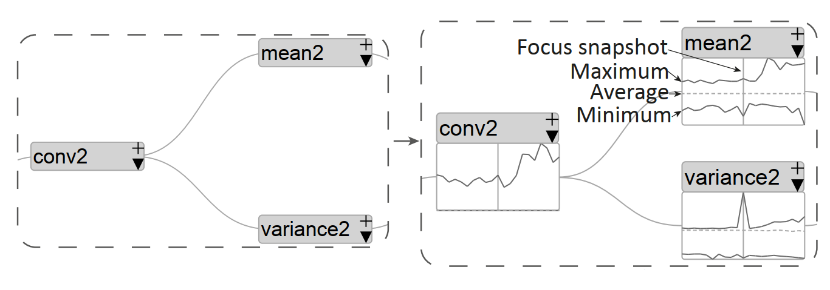
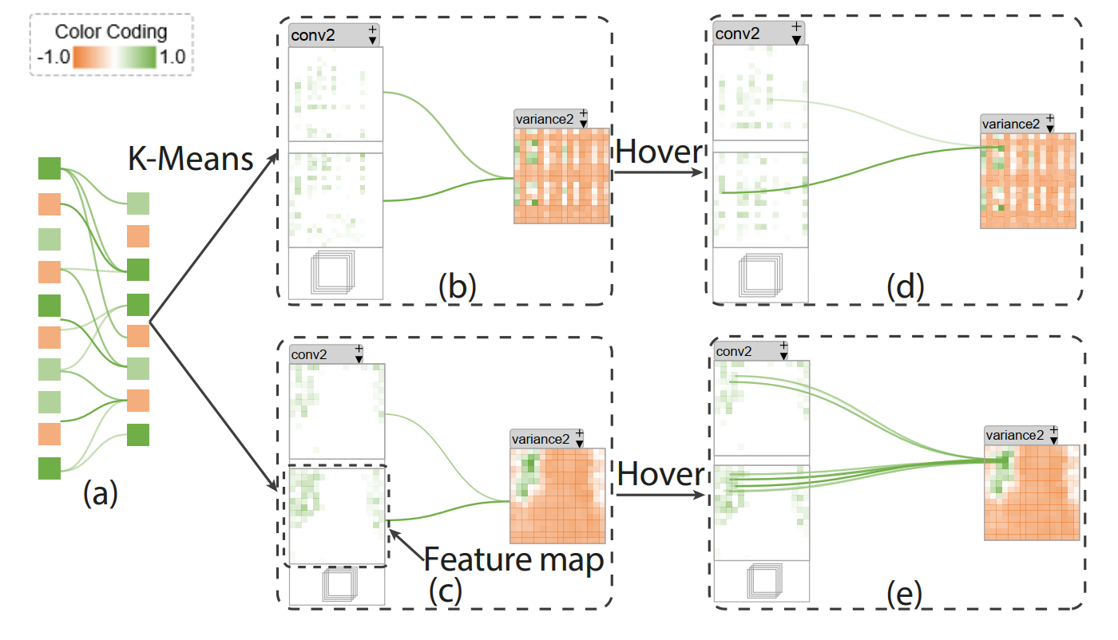
Analyzing DGMs
Multi-Level Analysis
Node Credit Assignment
Dataflow Visualization
Blue-Noise Sampling
[7]

Slide 21
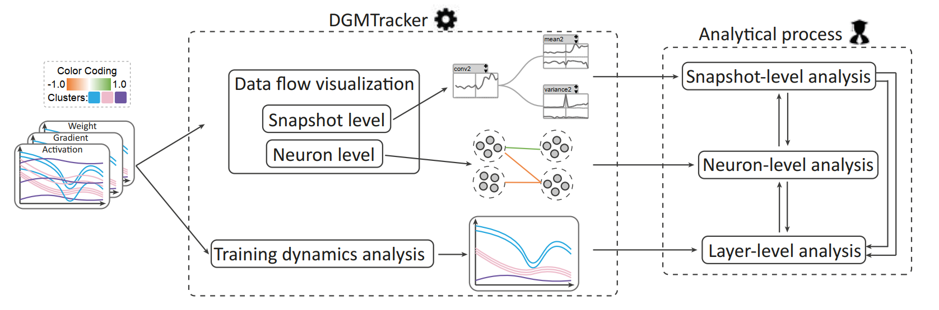
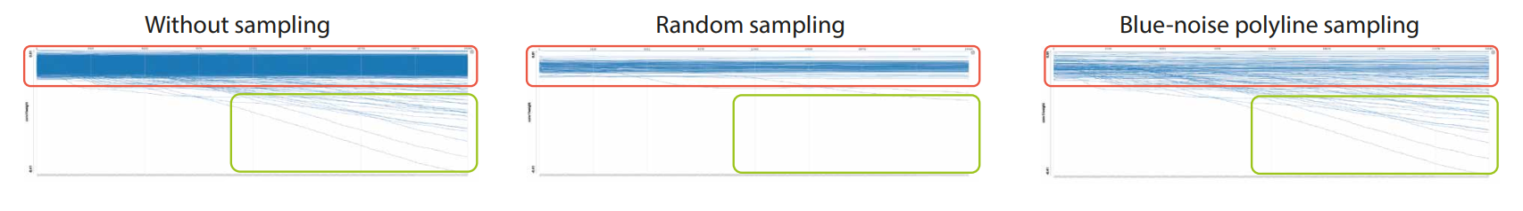
[7]

Slide 22
GANViz: Visual Analytics for GANs
Wang et al. 2015
[8]

Slide 23
GANZViz’s Features
Loss Function of G and D
Probability Values of D
Activations
Area Under Curve (AUC)

Slide 24
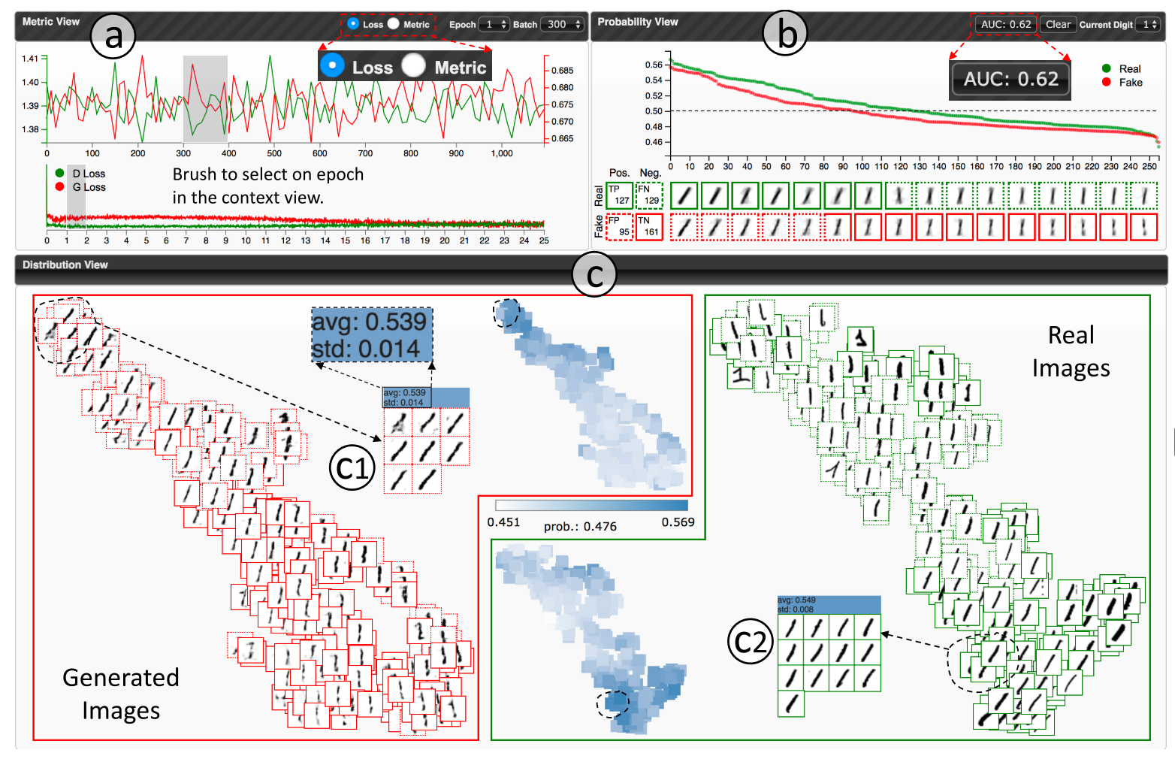
[8]

Slide 25
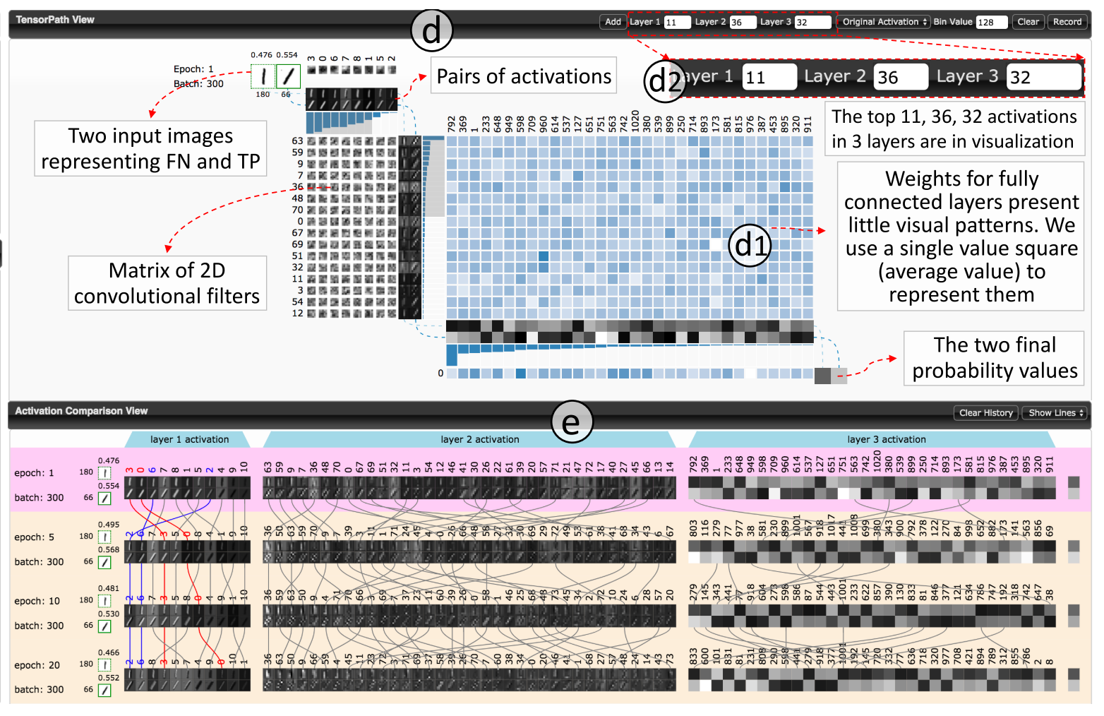
[8]

Slide 26
Loss Landscapes
Li et al. 2017
[9]

Slide 27
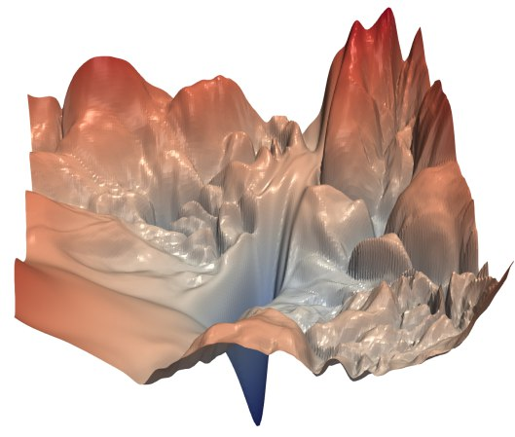
Loss Landscapes
1-3D Loss Representation
Dimensionality Reduction
Skip-Connections → Smoothness
[9]

Slide 28
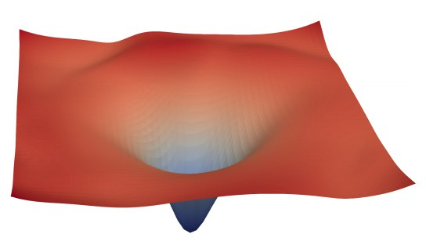
[9]

Slide 29
Comparison

Slide 30
Categories
What?
How?
When?
Network Architecture
Edge Weight
Convolutional Filters
Activations
Errors and Loss
Model Metrics
Node-Link Diagrams
Dimensionality Reduction and Scatter Plots
Line Charts
Notable Interactivity
Feature Visualization
During Training (Online)
After Training (Offline)

Slide 32
Neural Network Architecture
[1]

Slide 33
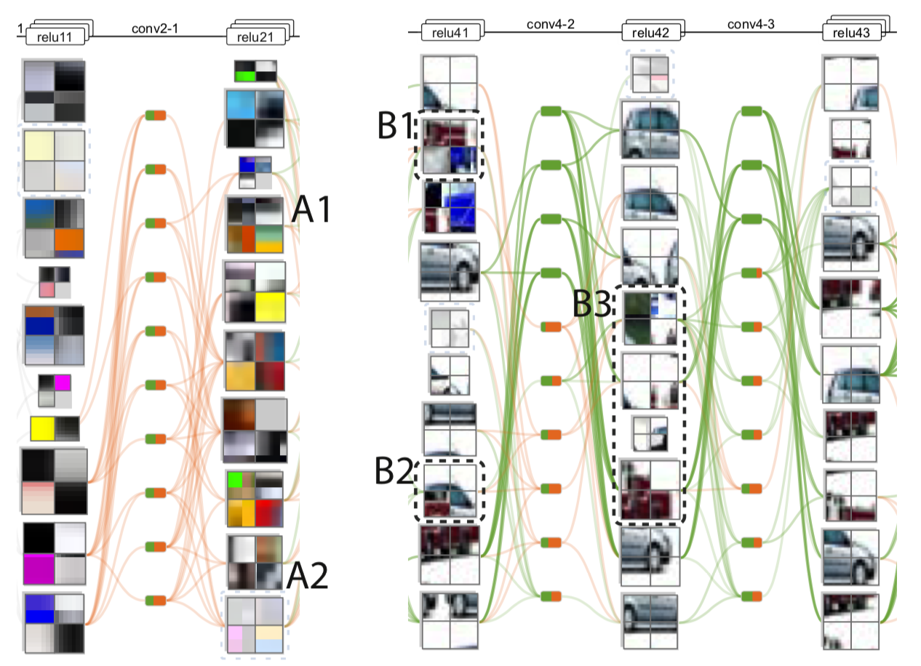
Neural Network Edges and Weights
[6]

Slide 34
Convolutional Filters
[6]

Slide 35
Convolutional Filters
[2]

Slide 36
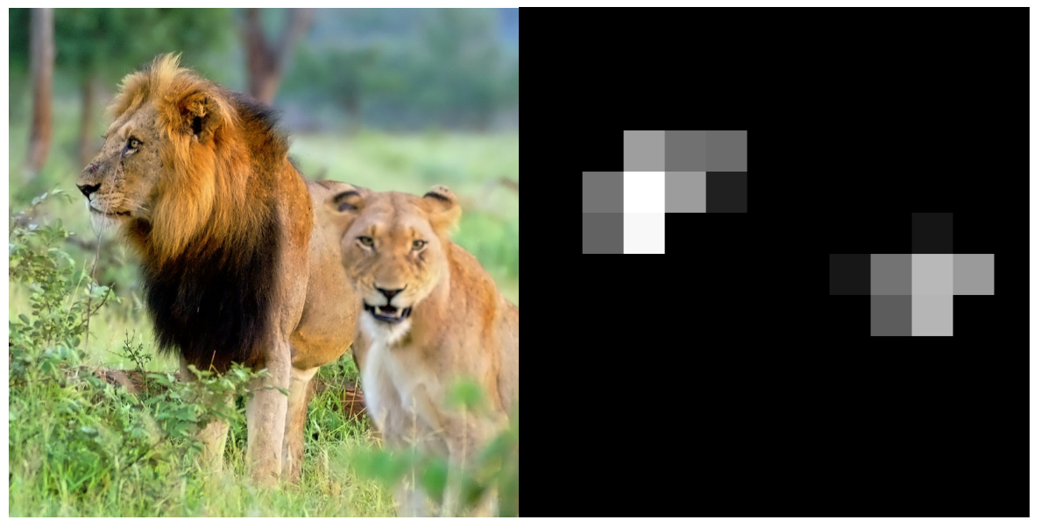
Activations
[3]

Slide 37
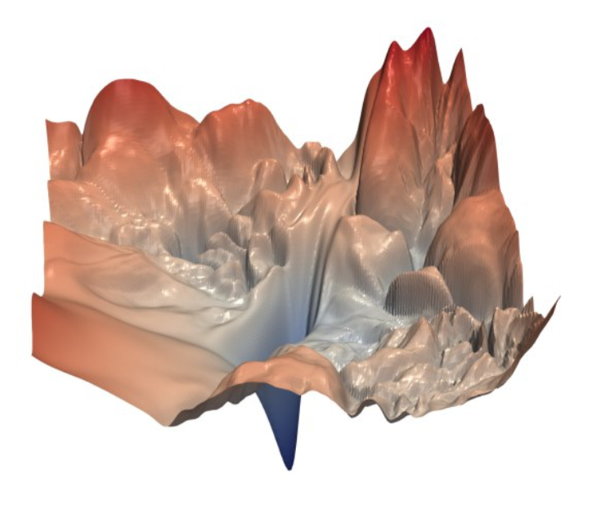
Errors and Loss
[9]

Slide 38
Model Metrics
[8]

Slide 40
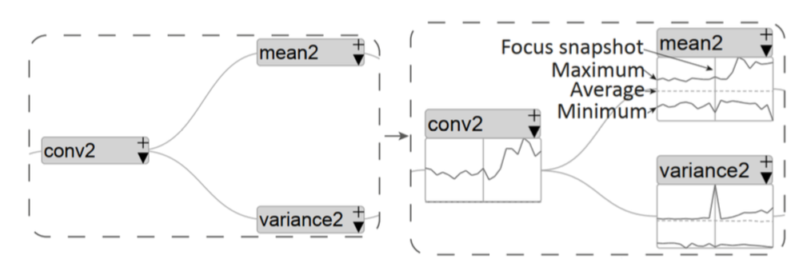
Node Link Diagrams
[7]

Slide 41
Dimensionality Reduction and Scatter Plots
[5]

Slide 42
Line Charts
[8]

Slide 43
Notable Interactivity
[2]

Slide 44
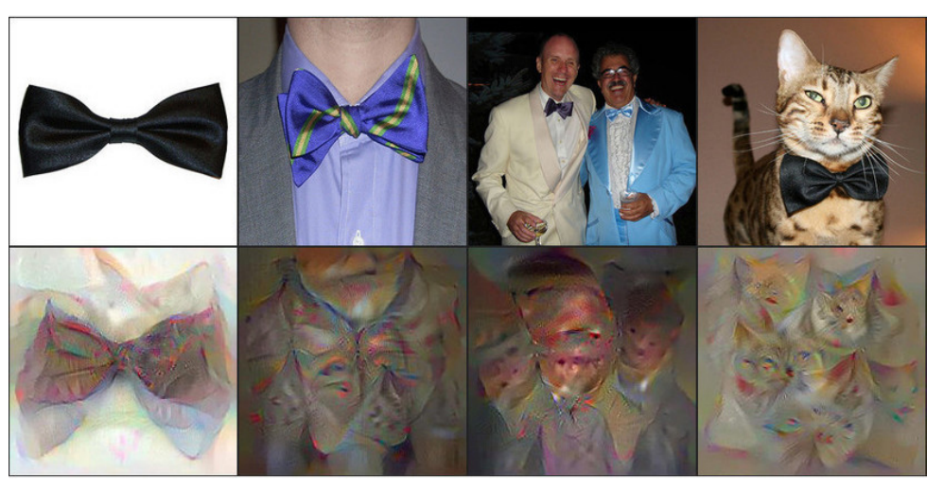
Feature Visualization
[5]

Slide 46
During Training (Online)
[8]

Slide 47
After Training (Offline)
[4]

Slide 48
Questions?

Slide 49
Sources
[1] WONGSUPHASAWAT, K., SMILKOV, D., WEXLER, J., WILSON, J., MANE, D., FRITZ, D., KRISHNAN, D., VIEGAS, F. B., AND WATTENBERG, M. 2018. Visualizing Dataflow Graphs of Deep Learning Mod- els in TensorFlow. vol. 24. jan, 1–12.
[2] SMILKOV, D., CARTER, S., SCULLEY, D., VIE ́GAS, F. B., AND WATTENBERG, M. 2017. Direct- Manipulation Visualization of Deep Networks. aug.
[3] YOSINSKI, J., CLUNE, J., NGUYEN, A., FUCHS, T., AND LIPSON, H. 2015. Understanding neural networks through deep visualization.
[4] SAMEK, W., BINDER, A., MONTAVON, G., LA- PUSCHKIN, S., AND MULLER, K.-R. 2017. Evaluat- ing the Visualization of What a Deep Neural Network Has Learned. vol. 28. nov, 2660–2673.
[5] NGUYEN, A., YOSINSKI, J., AND CLUNE, J. 2016. Multifaceted Feature Visualization: Uncovering the Different Types of Features Learned By Each Neuron in Deep Neural Networks.

Slide 50
Sources
[6] LIU, M., SHI, J., LI, Z., LI, C., ZHU, J., AND LIU, S. 2016. Towards better analysis of deep convolutional neural networks. IEEE transactions on visualization and computer graphics 23, 1, 91–100.
[7] LIU, M., SHI, J., CAO, K., ZHU, J., AND LIU, S. 2018. Analyzing the training processes of deep gen- erative models. IEEE Transactions on Visualization and Computer Graphics 24, 1 (Jan), 77–87.
[8] WANG, J., GOU, L., YANG, H., AND SHEN, H.-W. 2015. GANViz: A Visual Analytics Approach to Un- derstand the Adversarial Game. Tech. rep.
[9] LI, H., XU, Z., TAYLOR, G., AND GOLDSTEIN, T. 2017. Visualizing the loss landscape of neural nets. CoRR abs/1712.09913.

